Slide 1
EM parameterization of CF composite absorber
Capstone project proposal:
Sponsor: Tangitek LLC
Students: Ha Tran, Thanh Le, Jeffrey Brown
Advisor: Branimir Pejcinovic

Slide 2
Project requirements:
From 300 MHz to 30 GHz
EM parameter extraction:
Dielectric constant
Complex electric permittivity
Complex magnetic permeability
Loss tangent, absorption coefficient
Simulation model for validation
NRL arch measurement

Slide 3
Main phases:
Project info & planning (5 weeks)
Literature review on material characterization
Project requirement documents, test cases
Project schedule
Prototypes (9 weeks):
NRL Arch: from 8 GHz to 12 GHz
Waveguide: from 8 GHz to 12 GHz
EM Parameters extraction: use NRW algorithm and MATLAB
EM simulation: EM pro to simulate the material’s behavior
Production (5 weeks):
Expand frequency range
Optimization
Back-up and presentation

Slide 4
Approaches:
NRL Arch:
Advantage: Industrial standards, different incident/reflection angles
Disadvantage: Big sample size (greater than 5 wavelength), antenna alignment
Waveguide:
Advantage: Higher dynamic range, small sample size
Disadvantage: sample preparation (require perfect contact between sample and waveguides)
Software:
MATLAB for material extraction based on NRW algorithm [1], [2]
EMPro for EM simulation

Slide 5
Potential Problems and Solutions
Potential problems:
Solutions
Required sample size for NRL arch measurement in low frequency will be too large.
Antennas alignment is hard to be perfect.
Surrounding environment may affect measurements of the NRL measurement.
Sample preparation for waveguide measurement is not perfect and hard to align.
Sample for frequencies below 3 GHz can be 60cm x 60 cm for practical measurement [3]
Set up a simplified measurement to get the best possible arrangement for the arch measurement.
Use the anechoic chamber at PSU to take the measurements.
Design the sample holder waveguide for easy access and measurements. [3]

Slide 6
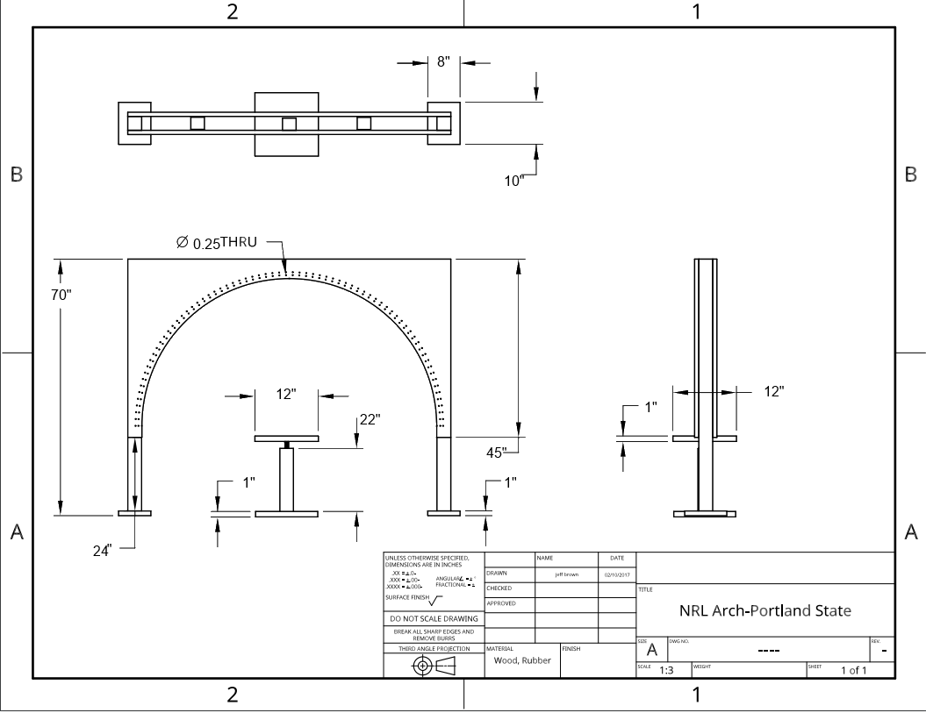
NRL arch prototype:
VNA is used as both the stimulus and detector of microwave signals.
Signal from the reflective plate (without the sample) provides a reference signal for calibration
Reflectivity in dB = 10*log10 (P1/P0)
Absorption coefficient of PVC is calculated and compared to reference [].
An arch with positioners will be built to measure reflection for different incident angles

Slide 7
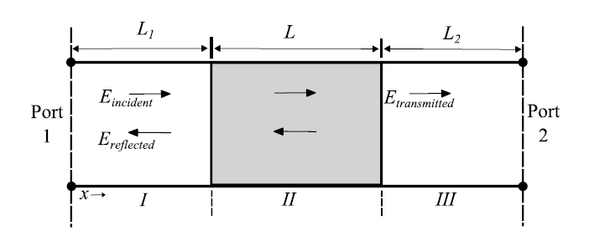
Waveguide Prototype:
L: a segment of rectangular waveguide where a sample has been placed using the waveguide a sample holder.
L1, L2: hollow rectangular waveguide
Port 1 and Port 2 are connected to VNA using adapters.
L.F. Chen et al 2004,
Microwave Electronics: Measurement and Materials Characterizationv [4]
Extraction algorithm for complex epsilon and mu are based on Microwave Electronics [4] and Nicolson Ross Weir’s algorithm and then will be implemented in MATLAB code.
A measurement and extraction will be applied on a control sample (PVC) to verify the initial result before performing on the CF absorber.
Christos Tsipogiannis, Master Thesis, Lund University,
Microwave materials characterization using waveguides and coaxial probe [2]

Slide 8
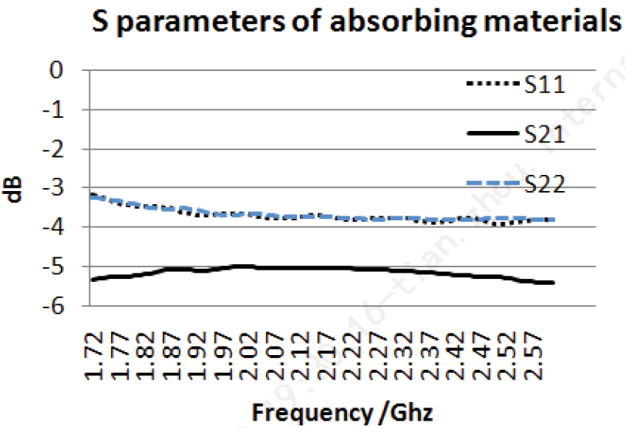
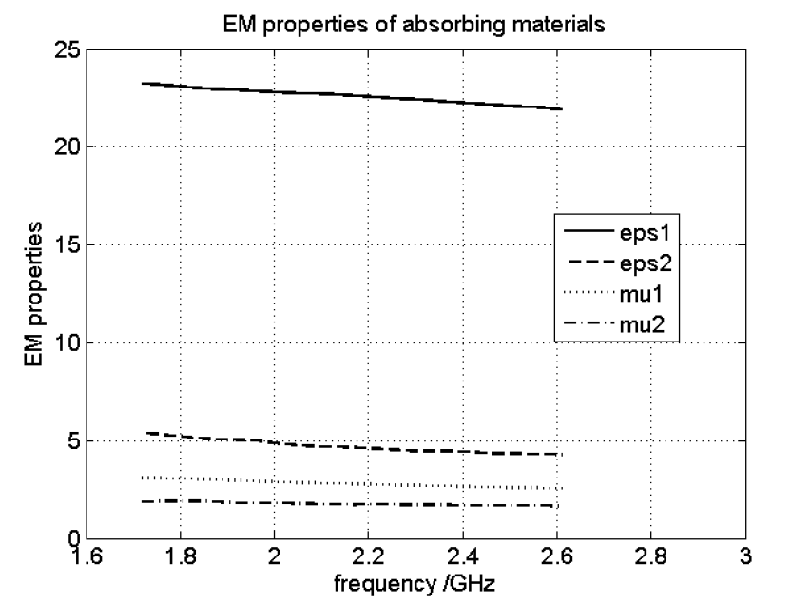
Description of Extraction and Simulation
MATLAB functions are used for extraction
Input: S11, S21, sample thickness, frequency band
Output: Complex permittivity and permeability
Functionality: EM properties extractions
EM Pro simulation
Input: Complex permittivity and permeability, sample thickness
Output: S11, S21
Functionality: Scattering parameter of simulation and measurement are compared for validation.
Tian Zhou* et al 2016,
“Measurement and Characterization of Flexible Absorbing Materials for Applications in Wireless Communication,” [3]

Slide 9
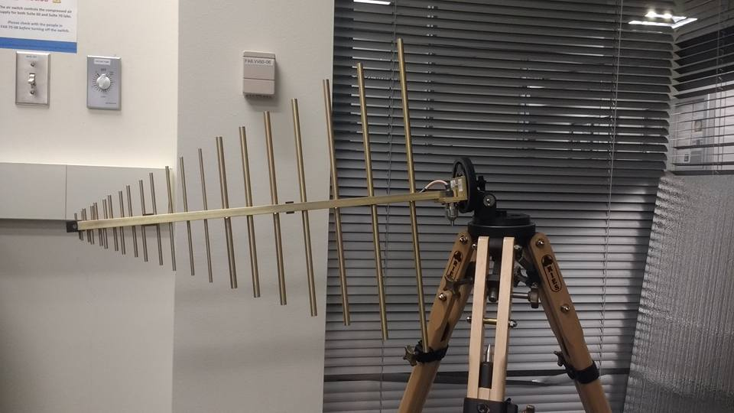
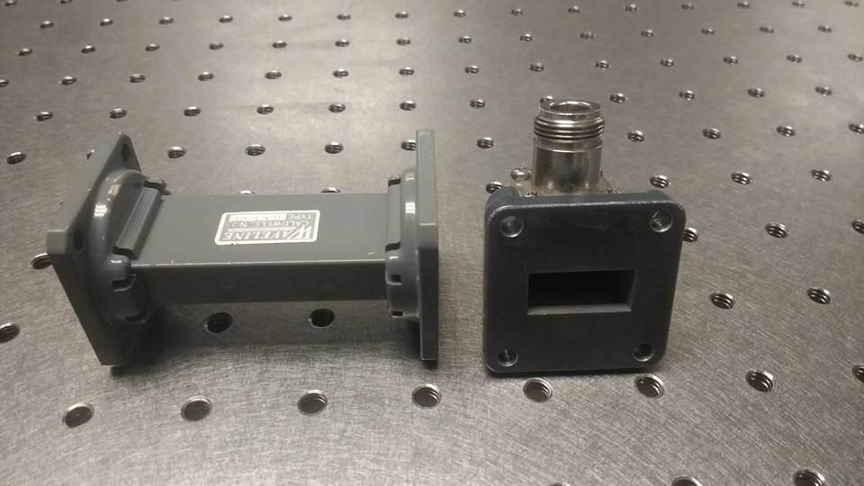
Available parts:
SAS-510-4 Log Periodic Antennas:
Frequency: 290 MHz to 4 GHz
Dimensions: 60.4 cm x 51.1 cm
Adjustable Dipole:
Frequency: 400 MHz to 1 GHz
Horn antennas in X-band
Frequency: 8.20 – 12.40 GHz
Dimensions: 7.4 x 5.5 cm
SMA cable for NRL measurement with length of 10ft (3 m)
1 straight waveguide section and 2 adapters in X-band
Frequency: 8.20 - 12.40 GHz
Dimension of aperture:
22.86 mm x 10.16 mm

Slide 10
Initial Needs
Sample with various size:
Waveguide (X-band): 22.86 x 10.16 x 5 mm
NRL Arch (up to 18 GHz): 30 x 30 x 0.2 cm 60 x 60 x 0.2 cm
Antennas for frequency range 4 – 8 GHz and above 12 GHz
Since the available antenna for frequency below 4GHz requires a large space for measurement set up we may need to have the horn antennas for this band.
Components for NRL Arch construction (Estimated cost: $150)
A sample holder (a segment of X-band waveguide that has suitable size for the sample)
TRL calibration kits :
Reflect standards: A X-band waveguide short plate
Line standards: A X-band waveguide segment (90 degree long line at center frequency).

Slide 11
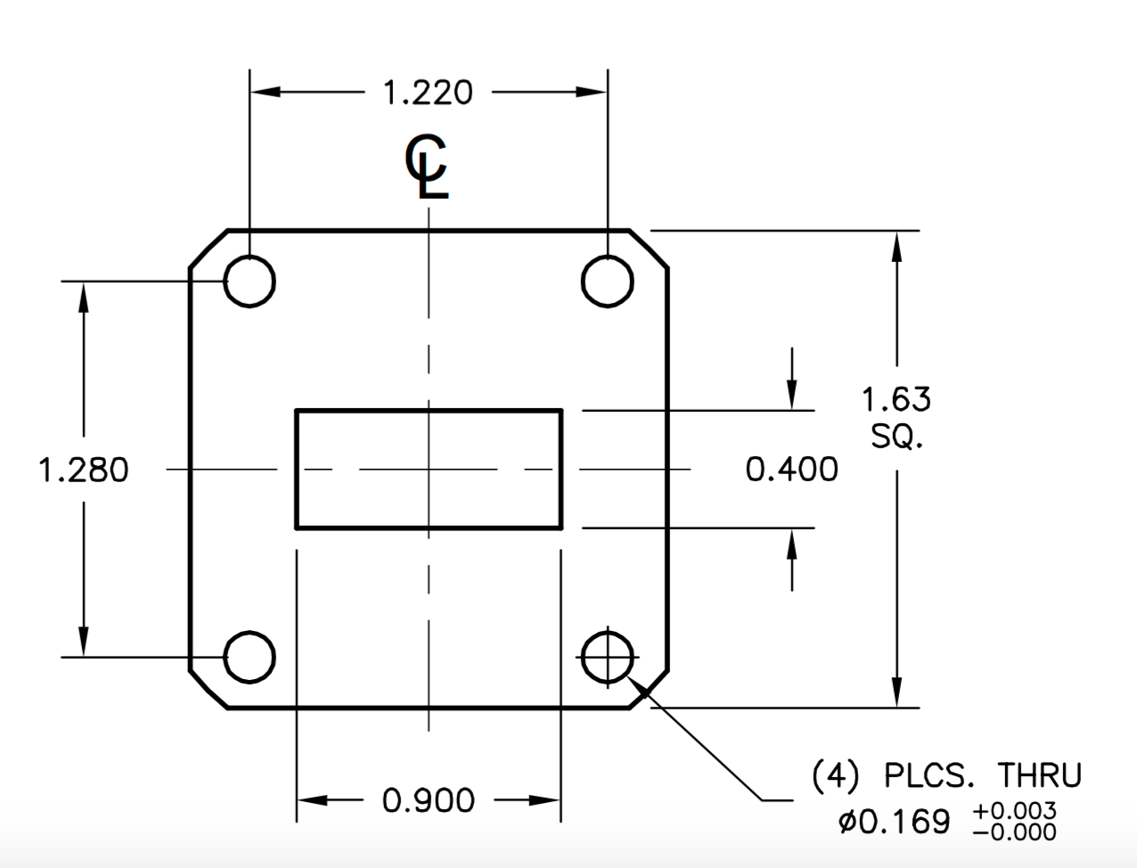
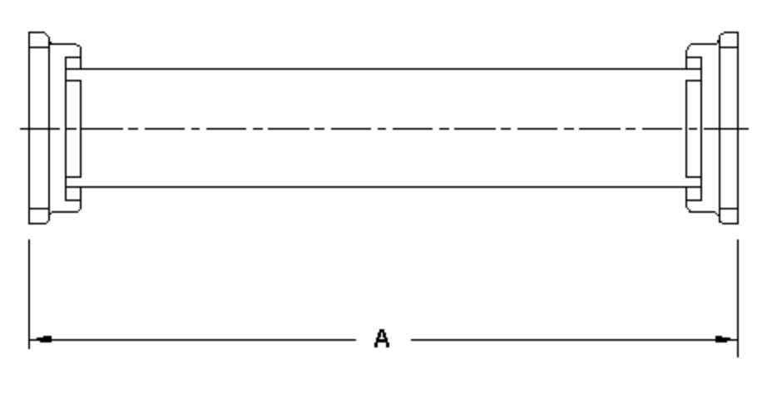
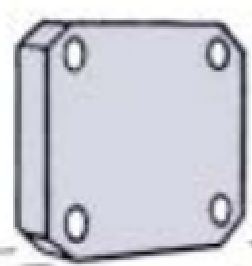
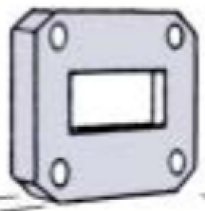
Sample Holder and TRL kit Information
From manufacturer
Frequency: X-band
Flange: UG-135/U
Price:
Short terminal: $40
Quarter wavelength: $80
Shim/Spacer (sample holder): $80
From design
Using 3D plot and 3D printing
Flange cross section (figure)
We can change length and thickness to get components.

Slide 12
Minimum and stretch goals
Measurement setup and characterization of material at frequency range of 8 – 12 GHz:
NRL measurement for absorbing coefficients
Waveguide measurement for S-parameters
Material EM parameters extractions
EM simulation
Expansion with time availability:
Expand the frequency of measurements and characterizations
Perform optimizations for measurements

Slide 13
Potential Optimization
Interactive Solver: Solving both material thickness and material properties at the same time. Provide higher accuracy.
Perform NRL Arch measurement in anechoic chamber to eliminate surrounding affects.
Perform free-space TRL calibration in NRL measurement
Partially filled waveguide measurement to compare result with the fully filled waveguide method.

Slide 14
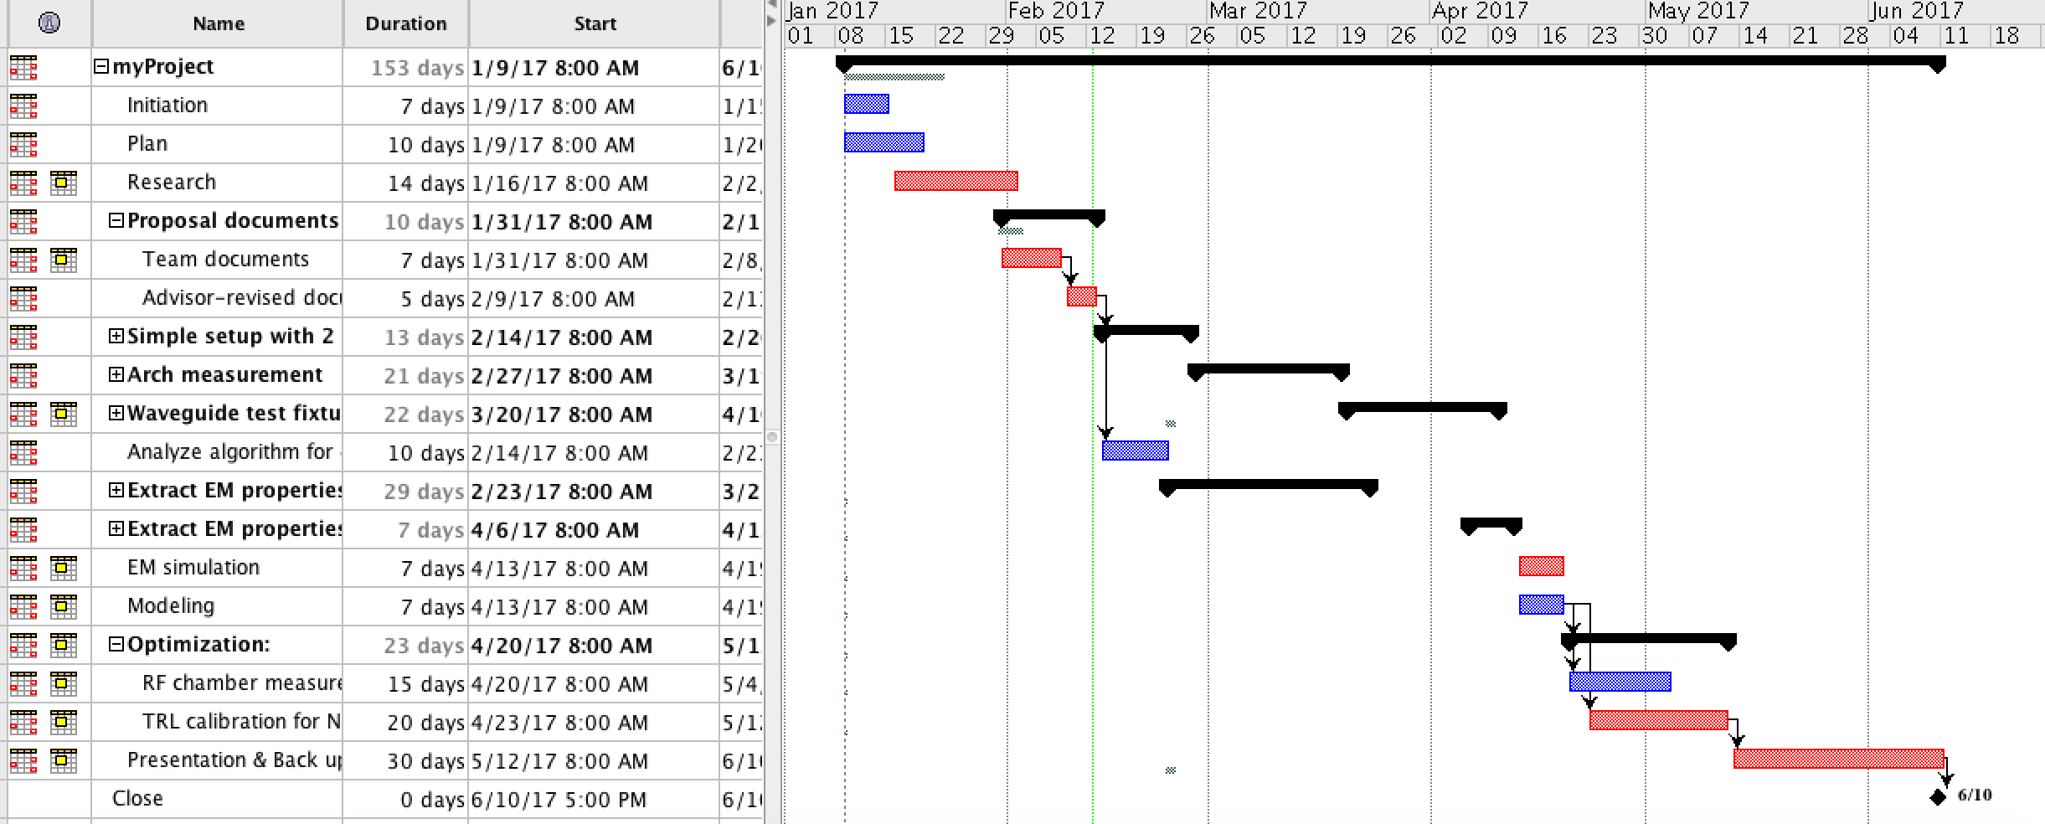
Project Management Detail

Slide 15
Current Status
Finish detail time plan (using Gantt chart).
Finish research literature review.
Finish gathering parts avaialble at PSU.
Equations, extraction algorithm and measurement setup for prototype of NRL arch and waveguide are available.
Related Documents
All related documents are available on GitHub https://github.com/trankhiemha/ECE412-413-Capstone-Project-N3
Project progression tracking is available on Trello https://trello.com/b/Ov0bqGiB/initial-cf-planning
Research papers are on Zotero page: https://www.zotero.org/groups/957151/items

Slide 16
Reference
[1] K. Belvin, “Examining 3D Printed Antennas For Space Based Applications,” 2015.
[2] Christos Tsipogiannis, “Microwave materials characterization using waveguides and coaxial probe.” [Online]. Available: http://lup.lub.lu.se/luur/download?func=downloadFile&recordOId=3359623&fileOId=3359627. [Accessed: 30-Jan-2017].
[3] Tian Zhou*, D. Wel, S. Yang, G. Xu, and C. J. and Z. Zhao, “Measurement and Characterization of Flexible Absorbing Materials for Applications in Wireless Communication,” J. Sci. Ind. Metrol., 2016.
[4] L. F. Chen, C. K. Ong, C. P. Neo, V. V. Varadan, and V. K. Varadan, “Transmission/Reflection Methods,” in Microwave Electronics, John Wiley & Sons, Ltd, 2004, pp. 175–207.

